Slide 1
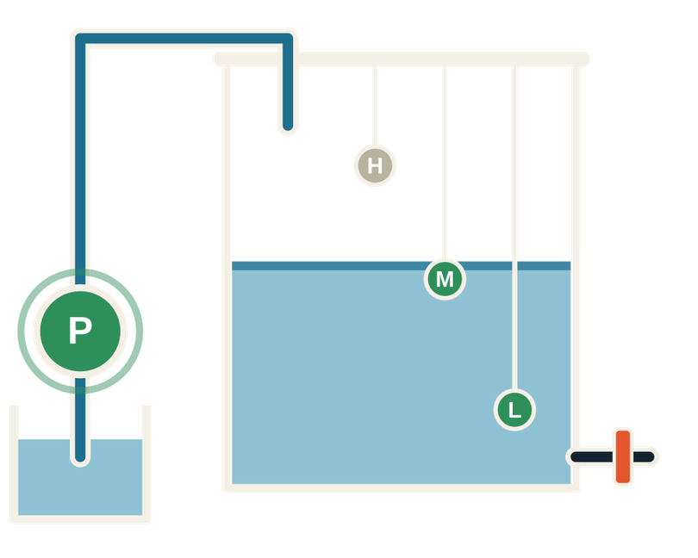

DIGITAL DESIGN & COMPUTER ARCHITECTURE
Smart Water Tank Overflow Protection & Pump Control System
DDCA
SENSORS IN → LOGIC GATES → PUMP OUT
A combinational-logic controller with no microcontroller
Miriyala Rupasri · Laxmi Sankeertana · Kashetti Ramyasri
AI & DS | Project Batch 09 | Guide: Dr Venkat Isampalli
K L Deemed to be University · Academic Year 2026–27 · FED

Slide 2


01 CONTEXT
Problem, objectives & project abstract
THE PROBLEM
OBJECTIVES
01
Overflow: pump continues after the tank is full, wasting water.
  Monitor water level using sensors at different heights.
  Switch the pump ON at low levels and OFF at the full threshold.
  Protect against overflow and unsafe operation.
  Use combinational gates only; simulate and verify the design.
02
Unsafe pump running: unwanted operation can stress the motor; the abstract also identifies dry-running risk.
03
Manual effort: someone must monitor the tank and switch the pump off.
ABSTRACT IN BRIEF
KEYWORDS
Three water-level sensors feed logic gates that determine the pump state: ON while the level is below full and readings are valid, OFF at the threshold or when readings are impossible. The low-cost design uses no microcontroller and is simulated to check water-level control, reduced wastage and safe operation.
Smart Water Tank
Overflow Protection
Pump Control
Combinational Logic
Digital Circuit Design
Water-Level Sensors
Automation
Resource Management
In one line: three sensors + a few gates + a pump; the circuit itself is the controller.
Smart Water Tank Overflow Protection & Pump Control · DDCA · Batch 09
02 / 13

Slide 3
01 CONTEXT
How the project maps to DDCA
COURSE / HANDOUT CONNECTION
SEVEN-STEP DESIGN FLOW
Module 1 — Foundations | Logic gates, truth tables, Boolean basics, truth table → SOP → gates.
Module 2 — Combinational logic | Outputs depend only on current inputs; use K-map simplification and specification-based design.
Session 10 | Design methodology and case-study implementation.
CO1 / CO2 | Apply Boolean algebra and gates; design and simulate a combinational circuit.
Tools | Logisim Evolution for simulation; Git and GitHub for version control.
1
SPECIFY
Inputs, outputs and behaviour
2
TRUTH TABLE
All 8 sensor cases
3
EXPRESSIONS
Sum-of-products
4
SIMPLIFY
Boolean algebra and K-map
5
GATES
Draw the circuit
6
SIMULATE
Use Logisim Evolution
7
VERIFY
Match circuit outputs to the table
Steps 1–5 are designed on paper; steps 6–7 verify that the circuit behaves like the truth table.
Smart Water Tank Overflow Protection & Pump Control · DDCA · Batch 09
03 / 13

Slide 4
02 DESIGN
SYSTEM OVERVIEW, SIGNALS & SENSOR RULE
WATER-LEVEL SENSORS
→
LOGIC UNIT
→
PUMP / FAULT
Low (L), Mid (M), High (H)
A probe outputs 1 when wet.
NOT, AND and OR gates
produce P and F.
P controls the pump;
F lights on impossible readings.
SIGNAL DEFINITIONS
THERMOMETER RULE
Signal | Type | Meaning when 1
L | Input | Water touches low sensor
M | Input | Water touches mid sensor
H | Input | Water touches high sensor (full)
P | Output | Run the pump
F | Output | Fault: impossible sensor readings
Water fills from the bottom, so a higher probe can only be wet when every lower probe is wet too.
Valid readings: 000, 100, 110, 111
Any other combination indicates a stuck/broken sensor. Run P only when H = 0 and readings are valid; otherwise stop the pump.
Smart Water Tank Overflow Protection & Pump Control · DDCA · Batch 09
04 / 13

Slide 5
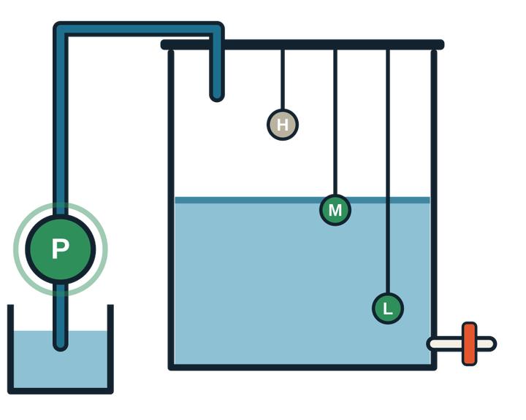
02 DESIGN
Truth table: all eight sensor combinations
Pump runs below full when readings are valid. Impossible combinations force P = 0 and F = 1.
L | M | H | Tank state | P (pump) | F (fault)
0 | 0 | 0 | EMPTY | 1 | 0
0 | 0 | 1 | FAULT | 0 | 1
0 | 1 | 0 | FAULT | 0 | 1
0 | 1 | 1 | FAULT | 0 | 1
1 | 0 | 0 | LOW | 1 | 0
1 | 0 | 1 | FAULT | 0 | 1
1 | 1 | 0 | MID (FILLING) | 1 | 0
1 | 1 | 1 | FULL | 0 | 0
P = 1 for 000, 100, 110 · P = 0 at full (111) · Fault rows fail safe: pump OFF, F = 1
Smart Water Tank Overflow Protection & Pump Control · DDCA · Batch 09
05 / 13

Slide 6
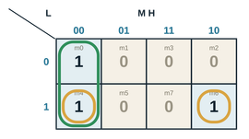
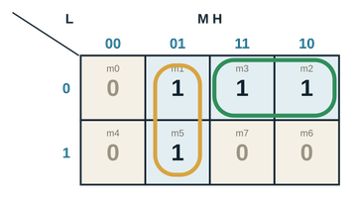
Boolean expressions & K-map simplification
THE FOUR CELLS WITH H = 0 FORM ONE GROUP; THE AMBER GROUPING IN THE ORIGINAL MAP WRAPS AROUND THE MAP EDGE.
SIMPLIFICATION REDUCES THE IMPLEMENTATION TO SMALL EXPRESSIONS USING ONLY NOT, AND AND OR GATES.
BOOLEAN RULES USED: FACTORING, X + X′ = 1, AND ABSORPTION.
PUMP OUTPUT P
FAULT OUTPUT F
K-MAP RESULT: P
K-MAP RESULT: F
Minterms: 0, 4, 6
Minterms: 1, 2, 3, 5
F = L′M + M′H
P = L′M′H′ + LM′H′ + LMH′
P = M′H′ + LMH′ = H′(M′ + LM)
P = H′(L + M′)
F = L′M′H + L′MH′ + L′MH + LM′H
GROUP TERMS USING H′ + H = 1 AND L′ + L = 1
F = L′M + M′H
P = M′H′ + LH′ = H′(L + M′)
02 DESIGN
SMART WATER TANK OVERFLOW PROTECTION & PUMP CONTROL · DDCA · BATCH 09
06 / 13

Slide 7
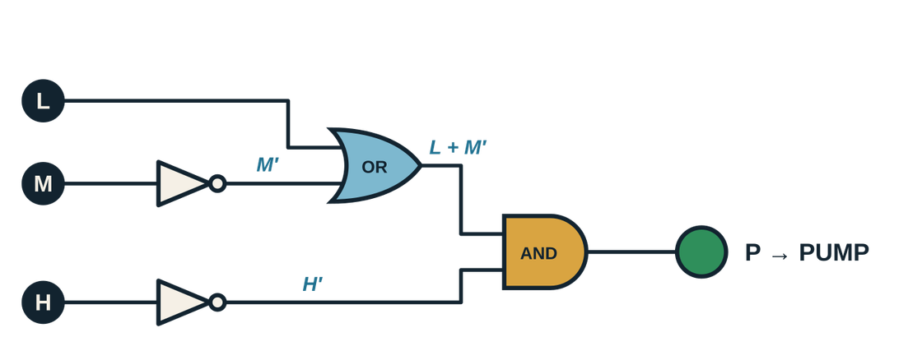
02 DESIGN
Fail-safe design choice & pump-control circuit
OPTION A — IMPOSSIBLE ROWS ARE DON’T-CARES
OPTION B — IMPOSSIBLE ROWS FORCED OFF (CHOSEN)
P = H′
P = H′(L + M′)
Only 1 NOT gate for P, but a stuck sensor may allow the pump to keep running. No fault indication.
Uses extra gates but makes invalid sensor patterns fail safe: pump OFF and fault lamp ON.
PUMP LOGIC GATE PATH
GATE COUNT & OPTIMISATION
NOT: 3 (L′, M′, H′)
AND: 3 (P: 1, F: 2)
OR: 2 (P: 1, F: 1)
Total: 8 gates • 3 inputs • 2 outputs
NAND is universal: the controller could also be built from NAND gates alone.
Smart Water Tank Overflow Protection & Pump Control · DDCA · Batch 09
07 / 13

Slide 8
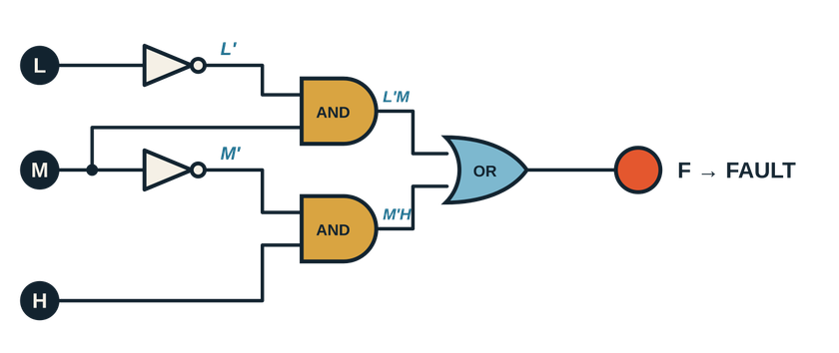
02 DESIGN
FAULT DETECTOR
COMPLETE CONTROLLER
Inputs: L, M, H • Outputs: P, F
P = H′(L + M′)
F = L′M + M′H
F = L′M + M′H
F becomes 1 for impossible patterns: 001, 010, 011 and 101.
BEHAVIOUR RULES
VALID + BELOW FULL
FULL (111)
IMPOSSIBLE READING
P = 1, F = 0
P = 0, F = 0
P = 0, F = 1
Block-diagram loop: water level rises → sensor states change → logic switches pump → level stops rising.
FAULT DETECTOR & COMPLETE LOGIC IMPLEMENTATION
Smart Water Tank Overflow Protection & Pump Control · DDCA · Batch 09
08 / 13

Slide 9
03 VERIFICATION
Logisim Evolution simulation & verification
All eight input combinations were checked. The circuit outputs match the truth-table outputs in every case.
L M H | P table | P circuit | F table | F circuit | Match
000 | 1 | 1 | 0 | 0 | ✓
001 | 0 | 0 | 1 | 1 | ✓
010 | 0 | 0 | 1 | 1 | ✓
011 | 0 | 0 | 1 | 1 | ✓
100 | 1 | 1 | 0 | 0 | ✓
101 | 0 | 0 | 1 | 1 | ✓
110 | 1 | 1 | 0 | 0 | ✓
111 | 0 | 0 | 0 | 0 | ✓
LOGISIM STEPS
1. Place input pins L, M and H.
2. Add 3 NOT, 3 AND and 2 OR gates.
3. Wire the gates as shown in the circuit design.
4. Add output LEDs for P and F.
5. Test all 8 input combinations and compare to the truth table.
RESULT: 8 OF 8 INPUT COMBINATIONS MATCH
Smart Water Tank Overflow Protection & Pump Control · DDCA · Batch 09
09 / 13

Slide 10
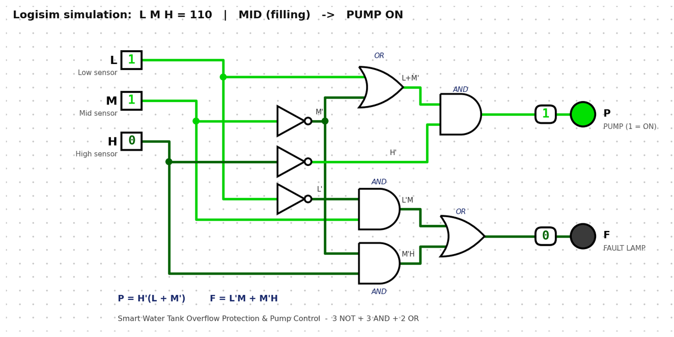
03 VERIFICATION
Logisim working model: complete circuit
Shown with sensors L M H = 110 (mid level): pump ON, fault lamp OFF.
CIRCUIT SUMMARY
Inputs: L, M, H sensors
Outputs: P (pump), F (fault lamp)
P = H′(L + M′)
F = L′M + M′H
Green wire = 1, dark wire = 0
All 8 input combinations match the truth table · Fault rows force the pump OFF
Smart Water Tank Overflow Protection & Pump Control · DDCA · Batch 09
10 / 13

Slide 11
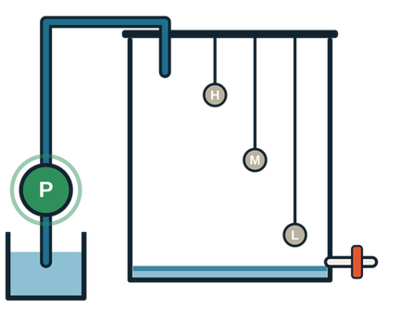
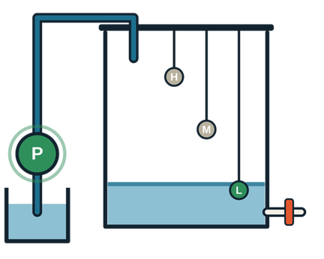
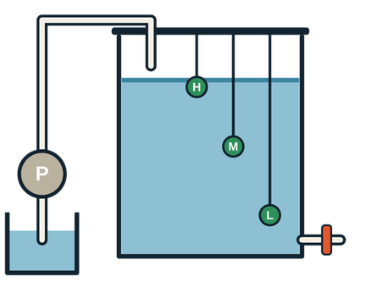
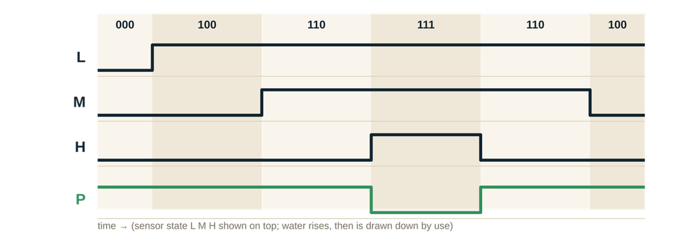
03 VERIFICATION
Working scenarios & expected behaviour over time
EMPTY
LOW
MID
FULL
L M H = 000
L M H = 100
L M H = 110
L M H = 111
PUMP ON
PUMP ON
PUMP ON
PUMP OFF
FULL FILL CYCLE
EMPTY → LOW → MID → FULL
The pump stays ON until H becomes 1; it then turns OFF. It turns ON again when H returns to 0, provided the readings are valid.
IMPOSSIBLE SENSOR EXAMPLE
001: high probe wet while low probe is dry
PUMP OFF • FAULT LAMP ON
Smart Water Tank Overflow Protection & Pump Control · DDCA · Batch 09
11 / 13

Slide 12
04 WRAP-UP
ADVANTAGES
LIMITATIONS
  Simple: three inputs and eight gates.
  Cost-effective: no microcontroller or code.
  Reliable: no software to hang; instant response to sensor changes.
  Fail-safe: impossible readings stop the pump.
  Saves water and helps protect the pump.
  No memory: pump restarts as soon as level dips below H (no hysteresis).
  No source-side sensor is included, so source-tank dry-run protection is not provided.
  Simulation only; a physical pump needs a driver stage.
APPLICATIONS
FUTURE SCOPE
  Domestic overhead tanks; apartments and hostels.
  Industrial/process tanks and agricultural irrigation reservoirs.
  Any level-controlled container with a pump.
  Add an SR latch or flip-flop for hysteresis (sequential logic).
  Add a source-tank sensor for true dry-run protection.
  Build in hardware or on an FPGA.
  Add buzzer/GSM alerts; extend to multiple tanks.
Advantages, applications, limitations & future scope
Smart Water Tank Overflow Protection & Pump Control · DDCA · Batch 09
12 / 13

Slide 13
04 WRAP-UP
Conclusion & references
CONCLUSION
REFERENCES
EIGHT LOGIC GATES HELP PREVENT OVERFLOW, RUN THE PUMP ONLY WHEN SAFE, AND FLAG FAULTY SENSOR READINGS.
  S. L. Harris & D. Harris, Digital Design and Computer Architecture: RISC-V Edition, Morgan Kaufmann, 2021.
  M. M. Mano & M. D. Ciletti, Digital Design, 6th ed., Pearson, 2018.
  T. L. Floyd, Digital Fundamentals, 11th ed., Pearson, 2014.
  D. A. Patterson & J. L. Hennessy, Computer Organization and Design: RISC-V Edition, 2nd ed., Morgan Kaufmann, 2020.
  Logisim Evolution — github.com/logisim-evolution/logisim-evolution
  Electronics Tutorials — electronics-tutorials.ws
  Course handout: Digital Design & Computer Architecture (26EC1202E), 2026–27.
TRUTH TABLE
EXPRESSIONS
8 cases • 2 outputs
P = H′(L + M′)
F = L′M + M′H
CIRCUIT
VERIFICATION
3 NOT • 3 AND • 2 OR
8 of 8 cases match
THANK YOU • QUESTIONS AND DISCUSSION
Smart Water Tank Overflow Protection & Pump Control · DDCA · Batch 09
13 / 13

